Slide 1
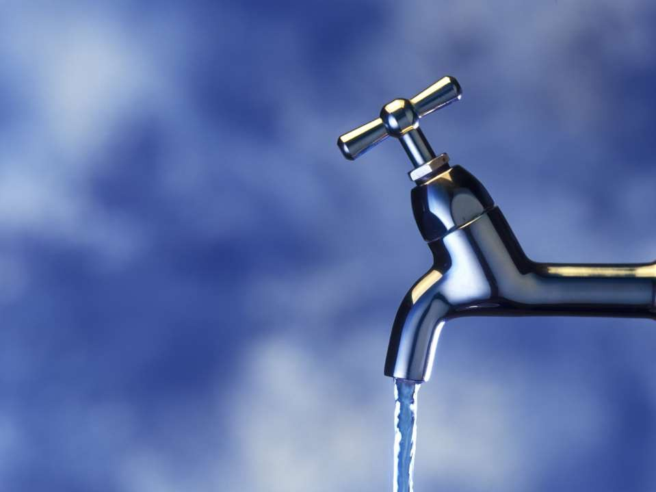
Determination of Hardness of Water

Slide 2

What is Hardness..?
Generally hardness of water is defined as the measure of capacity of water to precipitate soap i.e., the capacity of the water to form lather with soap.
Hard water contains dissolved minerals such as Ca²⁺, Mg²⁺, Fe³⁺, SO₄²⁻
etc.,
The degree of hardness is measured in Parts Per Million(ppm)
Water with different degrees of hardness is used for different purposes such as household and industrial purposes.

Slide 3

Why determine Hardness..?
It is essential to know the hardness of the water since it defines the purpose of it.
Hard water is not a health hazard but it cannot be used in industrial applications such as in boilers,pipes,etc.,
It has the tendency of forming CaCO₃ precipitate which later results in sludge/scale formation.

Slide 4
Determination of Hardness
The hardness of water can be estimated by methods such as gravimetric analysis, EDTA titration, atomic absorption, etc.,
In the above methods, EDTA titration is the most inexpensive and simple way of determining the hardness.
There are two types of hardness:Temporary and Permanent.
Temporary Hardness is due to the bicarbonate ions(Ca,Mg bicarbonates) being present in the water. It can be removed by heating the water.
Eg:Ca (HCO₃ )₂ ------> CaCO₃ +CO₂ +H₂O
Permanent hardness is due to chlorides and sulphates of Ca²⁺,
Mg⁺², Fe³⁺ and SO₄ ions and it cannot be removed by boiling.
-

Slide 5

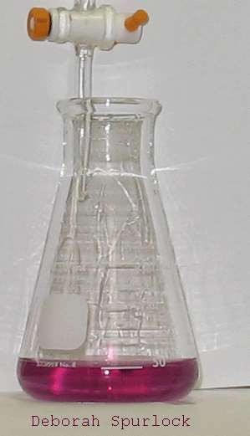
EDTA Titration
Permanent hardness is usually determined by titrating it with a standard solution of ethylenediamminetetraacetic acid, EDTA.
The EDTA is a complexing, or chelating agent used to capture the metal ions. This causes the water to become softened, but the metal ions are not removed from the water.
This method includes a series of titrations to determine the total,permanent,temporary,Ca, Mg hardness of the given water sample.
First the EDTA soln. is standardized by titrating it against a standard CACl₂ solution and its normality is found out. End point is appearance of steel blue color.

Slide 6
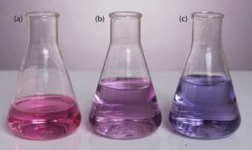
Then the total hardness is found out by titrating the water sample(added buffer soln and EBT indicator) against the standardized EDTA solution with end point as the same steel blue color.
The permanent hardness is found out by titrating a boiled and filtered hard water sample against EDTA solution.
Temporary hardness is found by subtracting the permanent hardness from the total hardness.
Colors of the soln before and after the titrations

Slide 7
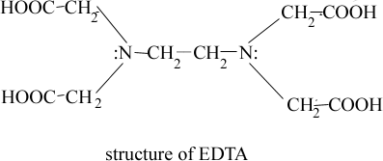
Mechanism…
EDTA is a versatile chelating agent. A chelating agent is a substance whose
molecules can form several bonds to a single metal ion. Chelating agents
are multi-dentate ligands. A ligand is a substance that binds with a metal ion to form a complex ion.Multidentate ligands are many clawed, holding onto the metal ion to form a very stable complex. EDTA can form four or six bonds with a metal ion, forming a stable complex.
•
_{Ca}2+
+ EBT ------> [Ca-EBT]
Unstable complex(Wine red)
[Ca-EBT] + EDTA -------> [Ca-EDTA] +
Stable complex (Colorless)
EBT
(Blue)
Same reaction occurs incase of Mg²⁺ also.
At the end of the titration EBT is released free, resulting in the formation of blue color.

Slide 8

Pros and Cons
ADVANTAGES:
It is a very simple and fairly accurate method.
It also very cost efficient as only a burette and a conical flask are required.
It also very quick and time efficient process when compared to gravimetric analysis.
DISADVANTAGES:
A disadvantage is that there might be some human errors due to the solutions made up by hand.

Slide 9
Simple Procedures
Ex No: 1
Deermination of Hardness (Ca²⁺) of Water using EDTA – Complexometry method
S.No | Content | Titration – I Standardization of EDTA | Titration-II Estimation of Total Hardness | Titration-III Estimation of Permanent Hardness
1 | Burette Solution | EDTA | EDTA | EDTA
2 | Pipette Solution | Standard Hard water (20 ml) | Sample Hard water (20 ml) | Boiled Hard water (20 ml)
3 | Additional Solution | Ammonia Buffer (5 ml) | Ammonia Buffer (5 ml) | Ammonia Buffer (5 ml)
4 | Indicator | EBT (2drops) | EBT (2drops) | EBT (2drops)
5 | Endpoint | Wine Red to Steel Blue | Wine Red to Steel Blue | Wine Red to Steel Blue

